Slide 1
Arduino Sensor Network System
Advisor : Dr. Tracy Camp
Peng Li

Slide 2
Background
Notes:
At first, I want to talk about some background about this project.

Slide 3
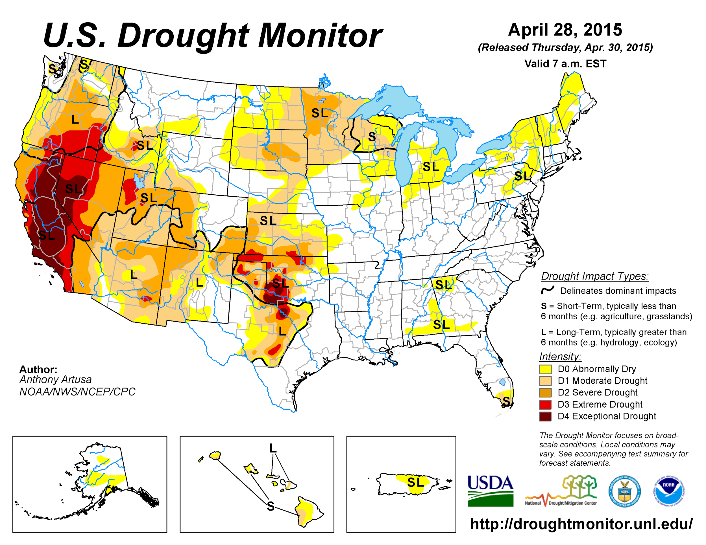
United States Drought Map
Notes:
In the past a few years, the United States, especially for the California, has experienced severe drought.

Slide 4
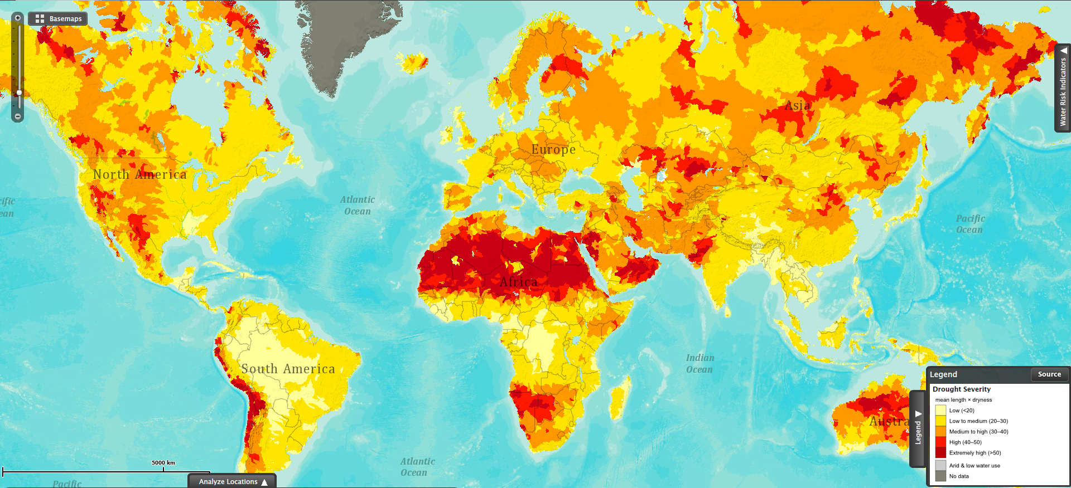
World Drought Map
Notes:
If we take our eyes to the whole world, we can see there is also a lot of place, a lot of people, they need more clean water.
So there is an urgent requirement for us to do something to improve the water use efficiency.

Slide 5
Traditional Solution
for Wastewater Treatment

Slide 6
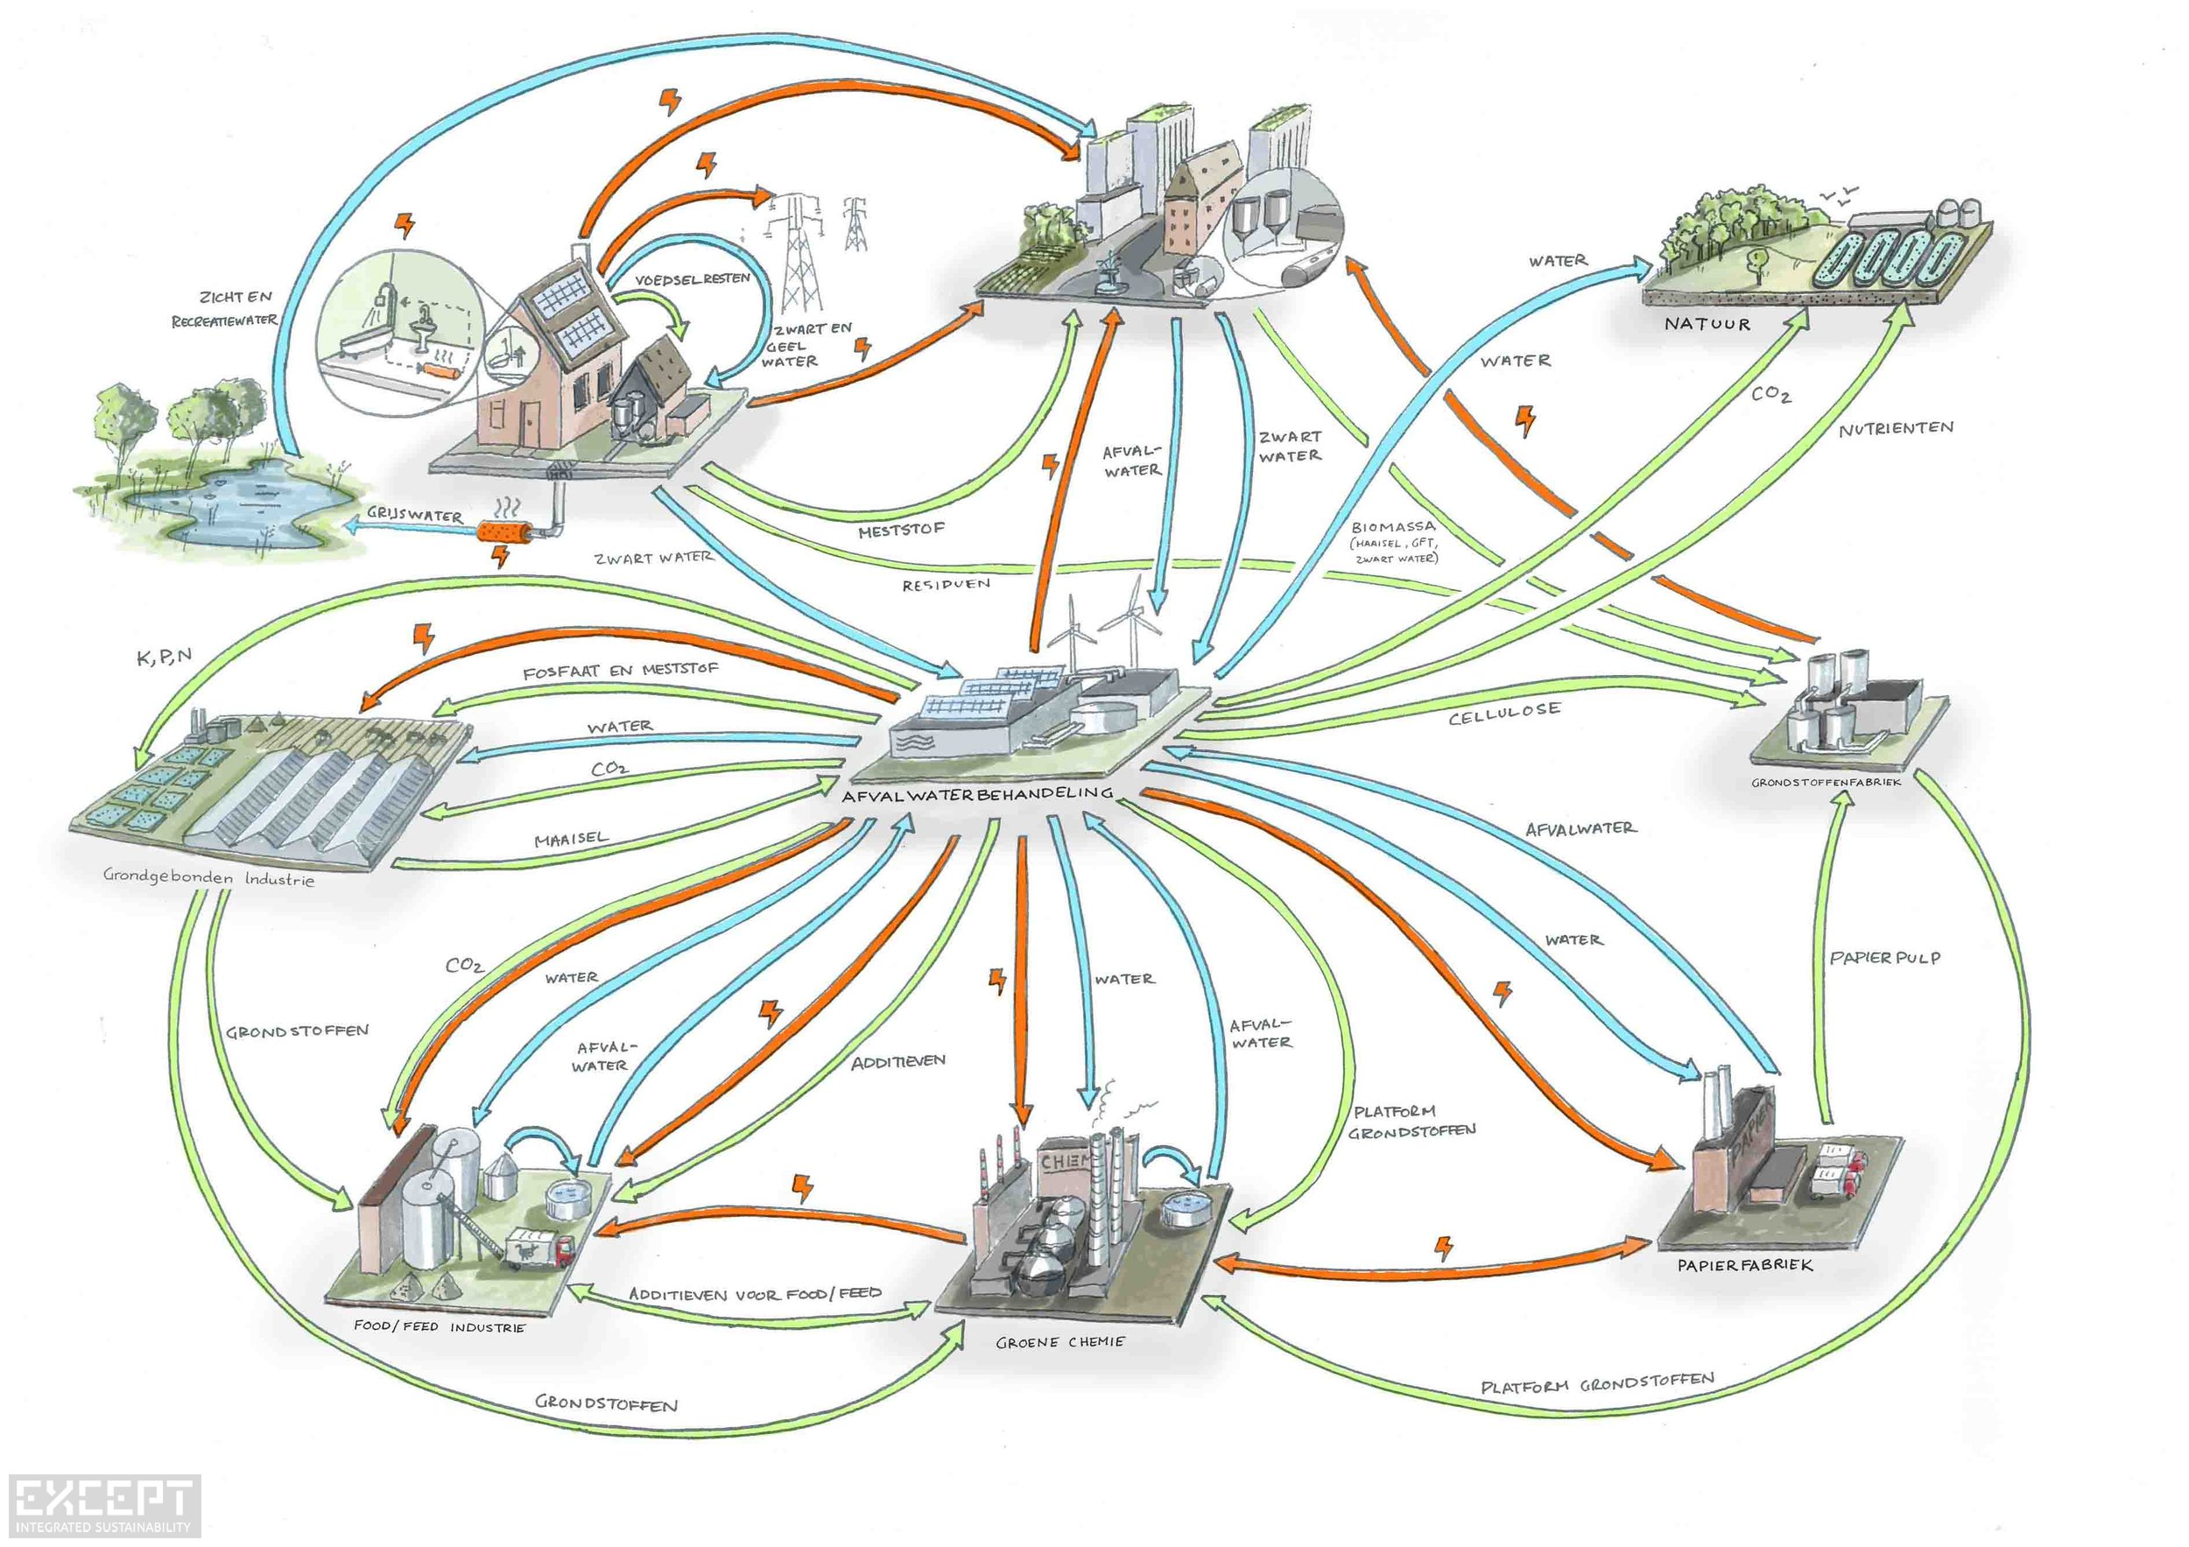
Centralized Wastewater Treatment System
Notes:
In the center, there is a wastewater treatment plant. Around it, there are school, factory, farm and city.
All the wastewater are sent to the this plant to be treated, and then, send back.
We should notice that, all the water that to be sent back, they are all in the drinking water quality.

Slide 7
Centralized Wastewater Treatment Systems
Different water quality requirements
drinking
urban irrigation
toilet flushing
waste
Notes:
At different place, the requirement for the water quality is also different.
It will be a big waste if we use clean drinking water to flush toilet.

Slide 8
Modern Solution
for Wastewater Treatment

Slide 9
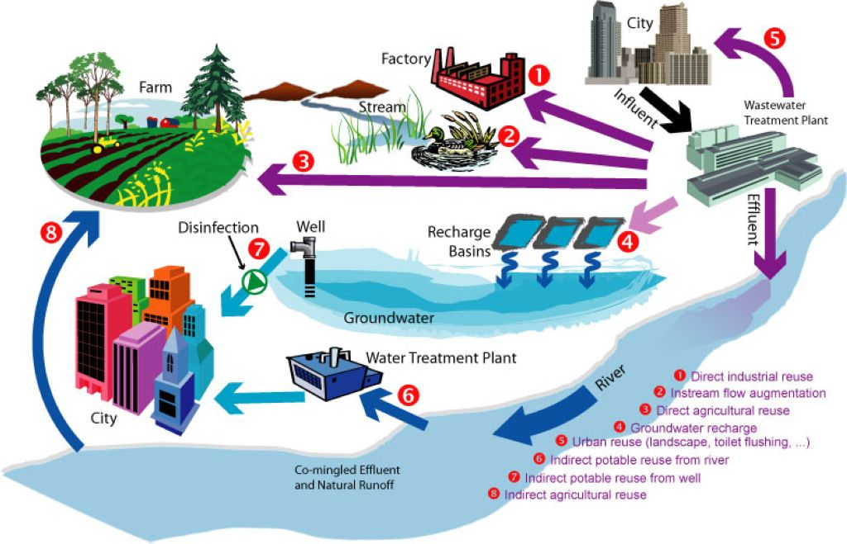
Decentralized Wastewater Treatment System
On-site
Remote
Notes:
This one is an on-site wastewater treatment plant. Typically, it should be pretty close to the community.
It will send back the wastewater with lower quality to some places like factory, farm or toilet.
Here is a remote wastewater treatment plant. It is used to produce clean water for normal use.
We can see, the decentralized system can significantly improve the water use efficiency.

Slide 10
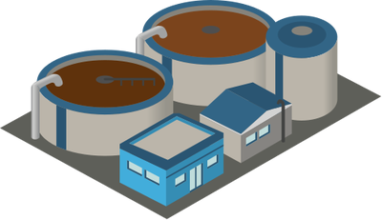
Mines Park Lab
Notes:
Interestingly, we just have a small on-site wastewater treatment plant in the Mines Park.
This project is currently running on the machines in the Mines Park Lab.

Slide 11
Project Features

Slide 12






Notes:
Basically, we have 6 main features in my project.

Slide 13
Devices
Notes:
The first one is Devices.

Slide 14

Hach Company
Notes:
Most of the device, used in the Mines Park Lab, are coming from a company call Hach

Slide 15
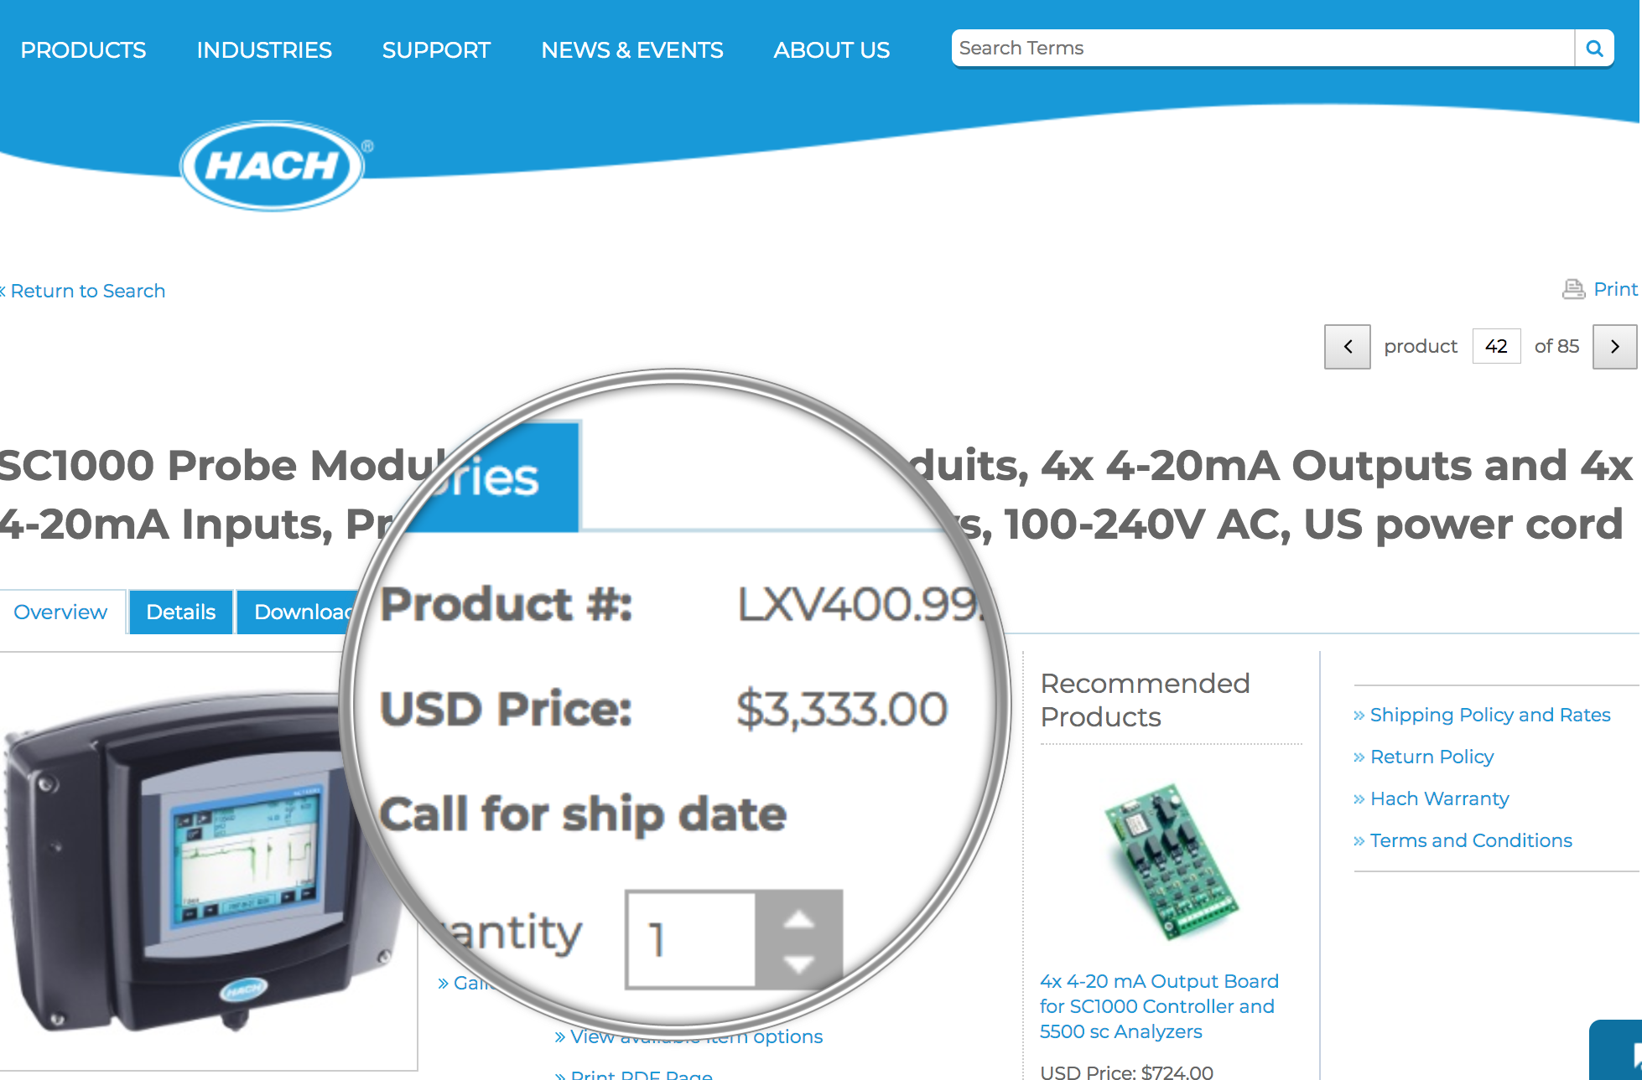
Hach Brand Controller(SC1000) Cost

Slide 16
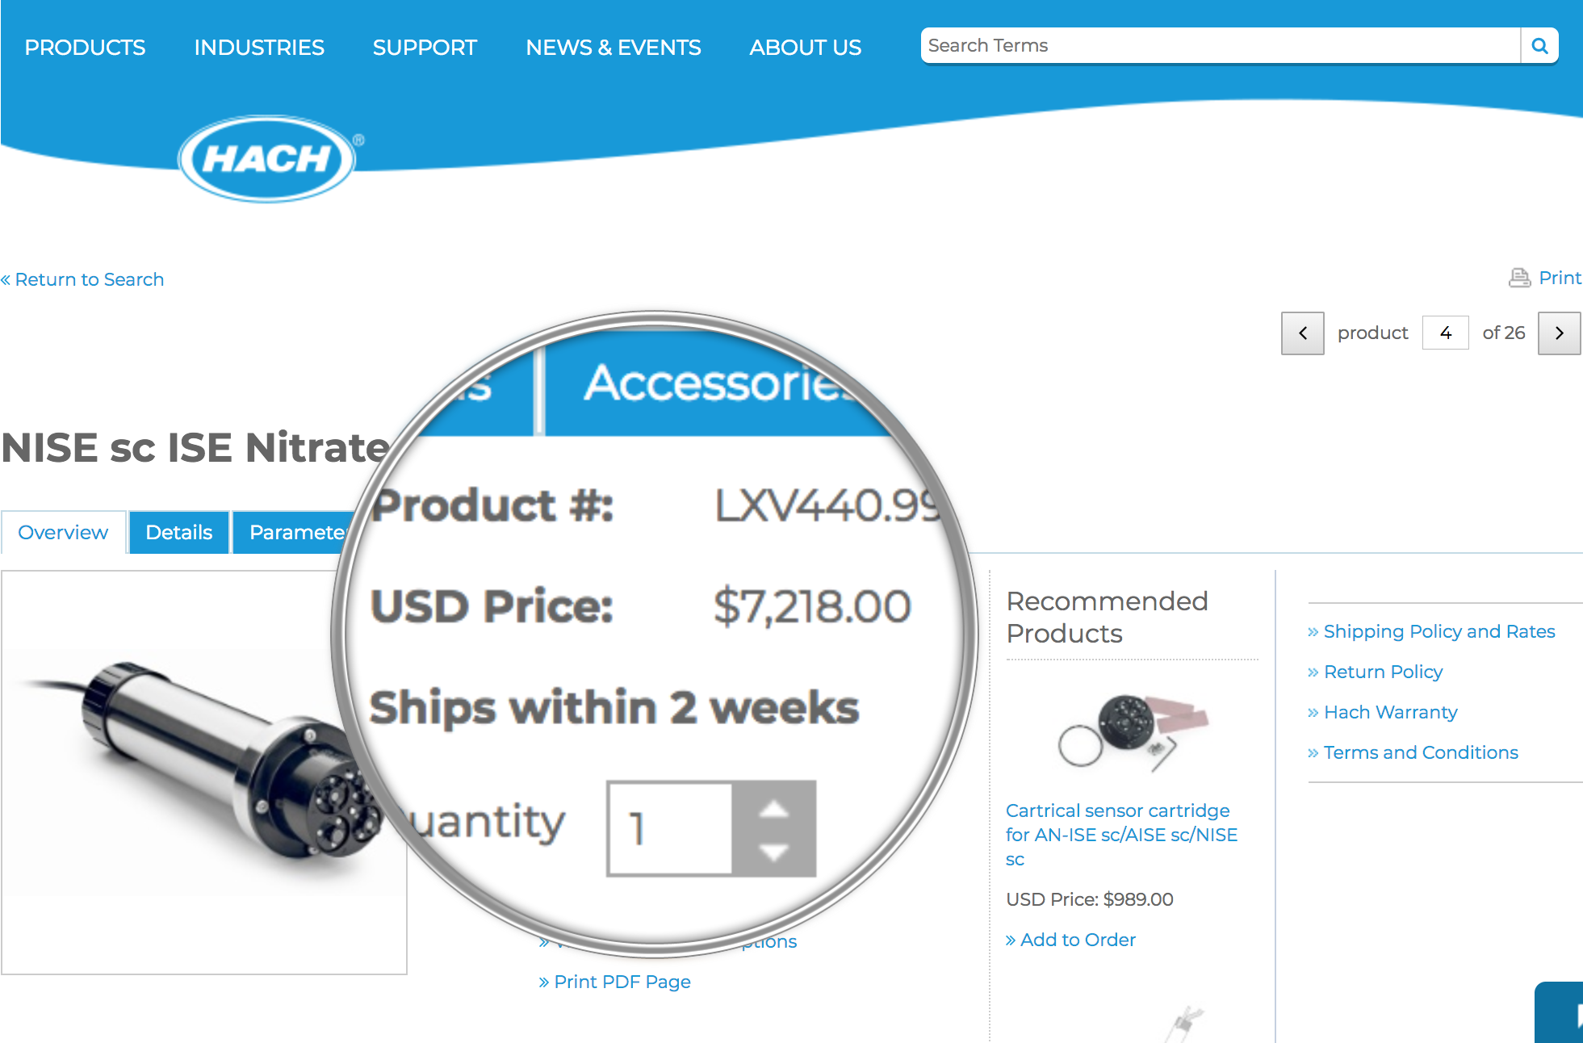
Hach Brand Sensor(Nitrate) Cost

Slide 17
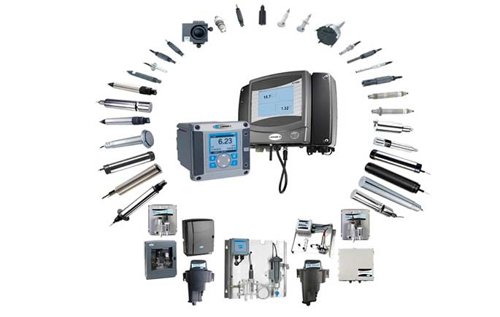

Hach Brand System Cost : $$$
Notes:
The whole system will cost millions of dollars.

Slide 18
Low-cost and Open Source Solution
Notes:
We found a low-cost and open source solution.

Slide 19

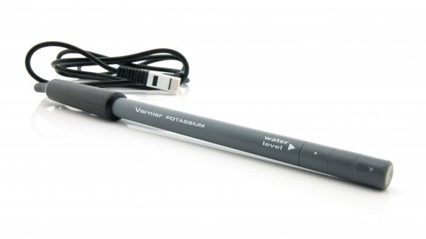
Arduino Controller + Vernier Sensor
Notes:
The Arduino is an open source hardware.
The Vernier is a chemical equipment manufacturer.

Slide 20
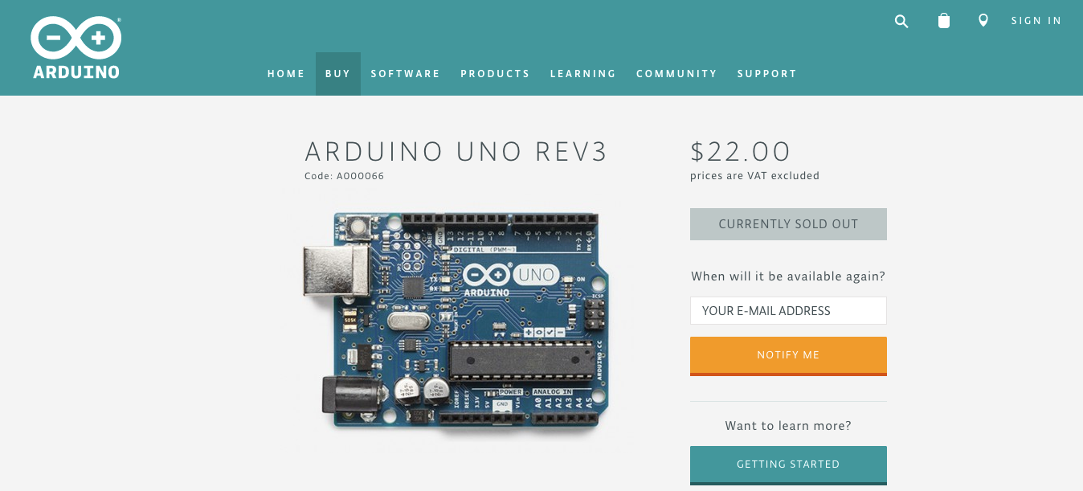
Arduino Cost

Slide 21
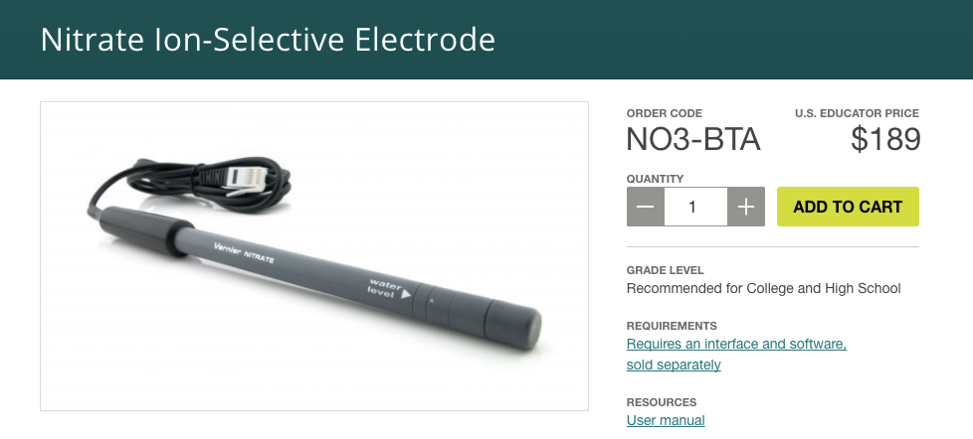
Vernier Brand Sensor Cost

Slide 22
Hach VS Arduino
 | Hach | Arduino
Controller | $ 3,000 | $ 20
Sensor | $ 7,000 | $ 200
Data | Limited Access | Fully Access

Slide 23
Devices
Wireless

Slide 24
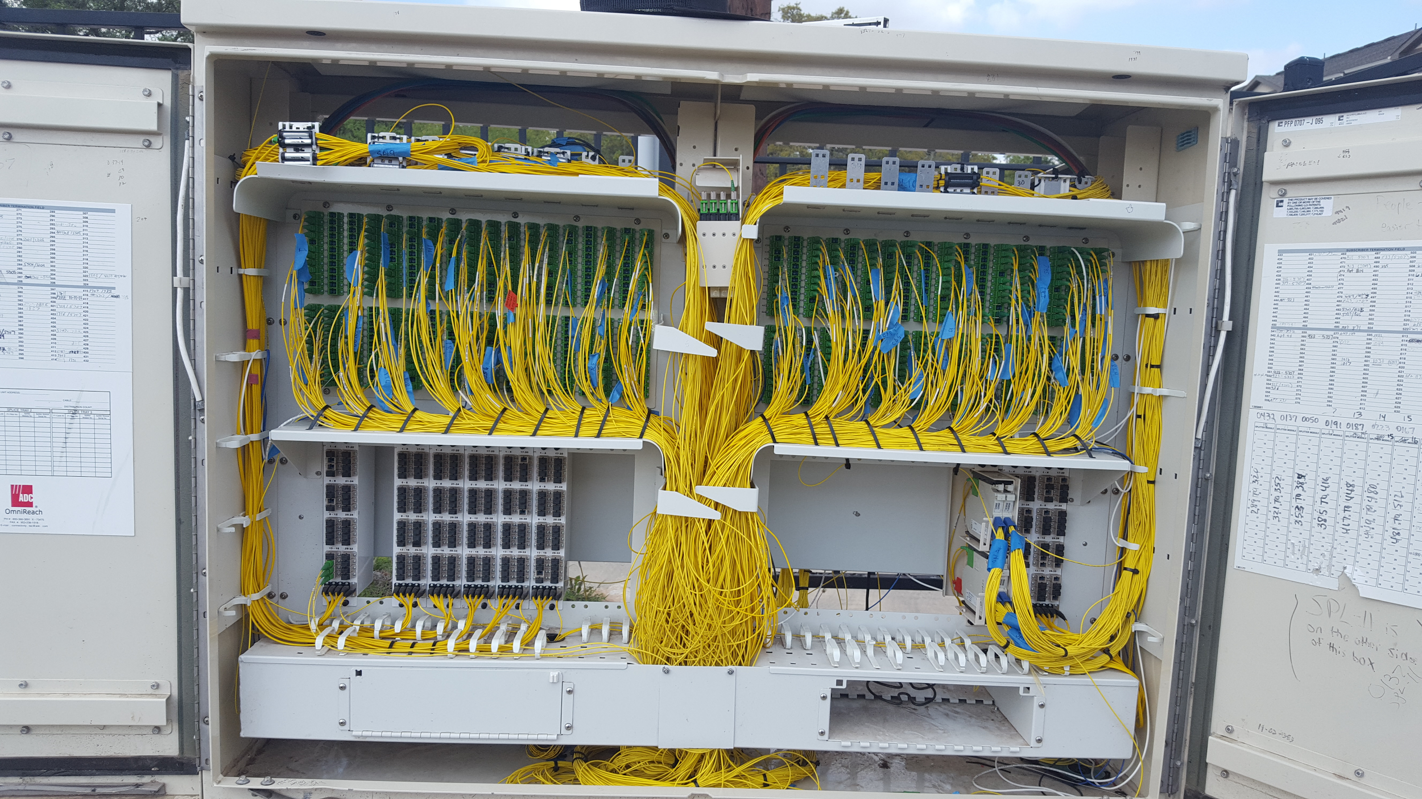
Ideal Condition with Wires

Slide 25
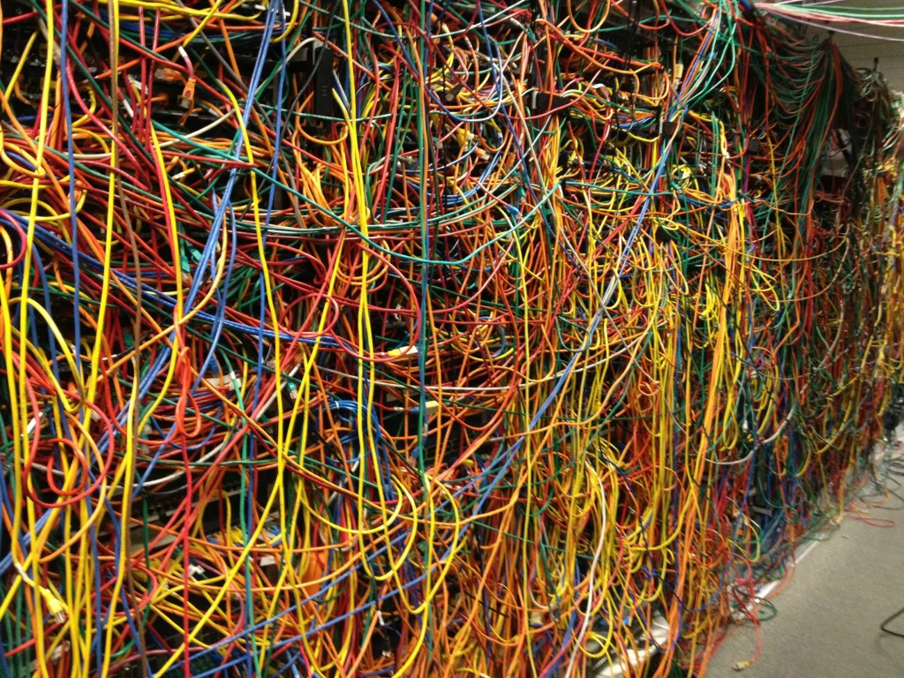
Sometimes ...
Notes:
But sometimes, it will mess up like the hell.

Slide 26
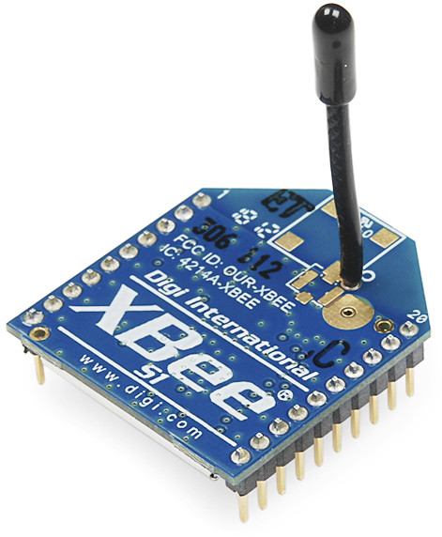
XBee Module
Notes:
Fortunately, there is a wireless transmission module compatible with Arduino devices.

Slide 27
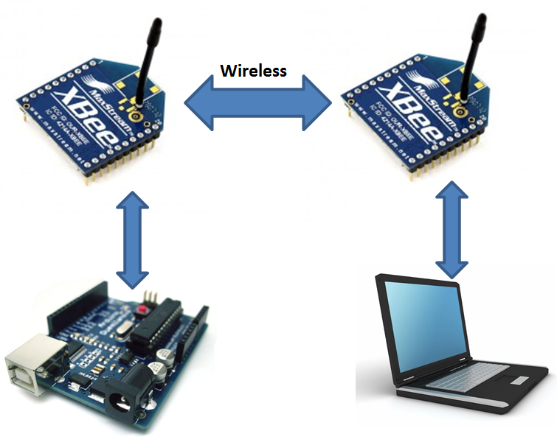

Data Flow
Wireless
Notes:
It will provide better convenience.

Slide 28
Devices
Wireless
Security

Slide 29
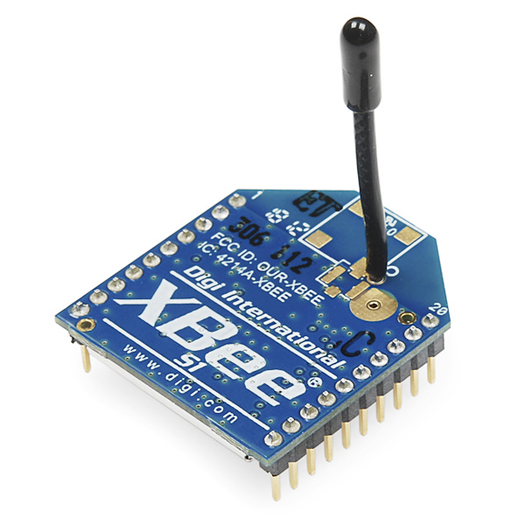

128 Bits AES Encryption

Slide 30
Data Flow with Encryption
Wireless
Encryption
Decryption
Notes:
It will provide better convenience.

Slide 31
Devices
Wireless
Security
Web

Slide 32
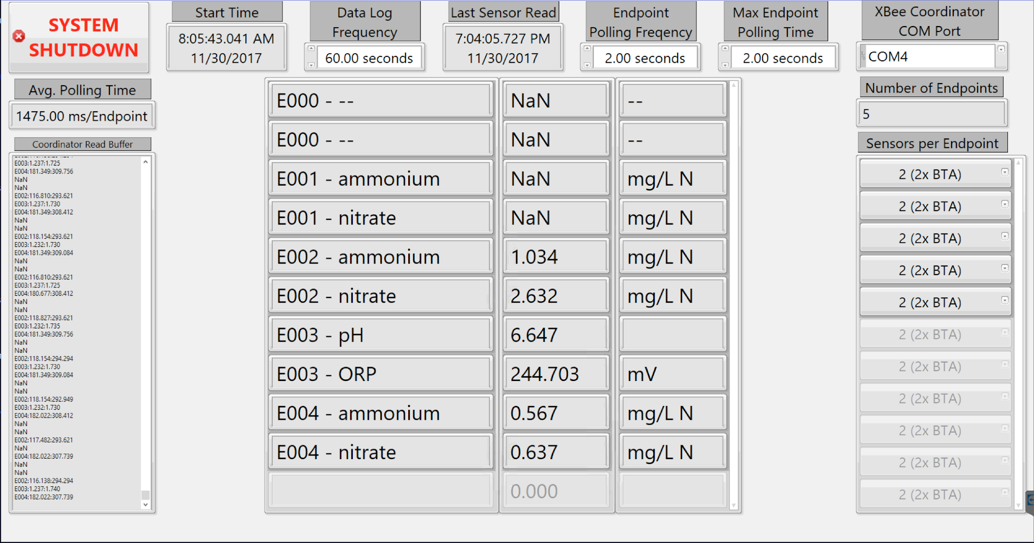
Current GUI in Mines Park Lab

Slide 33
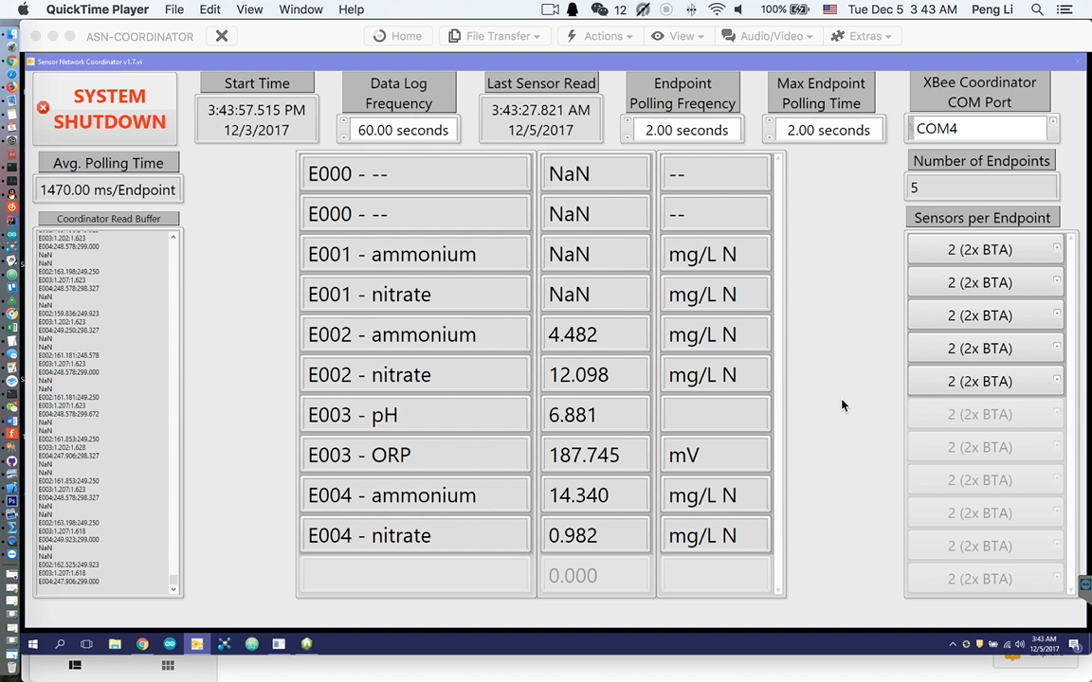
Notes:
Labview
It's pretty boring, right?

Slide 34
Web Browser based Interface

Slide 35
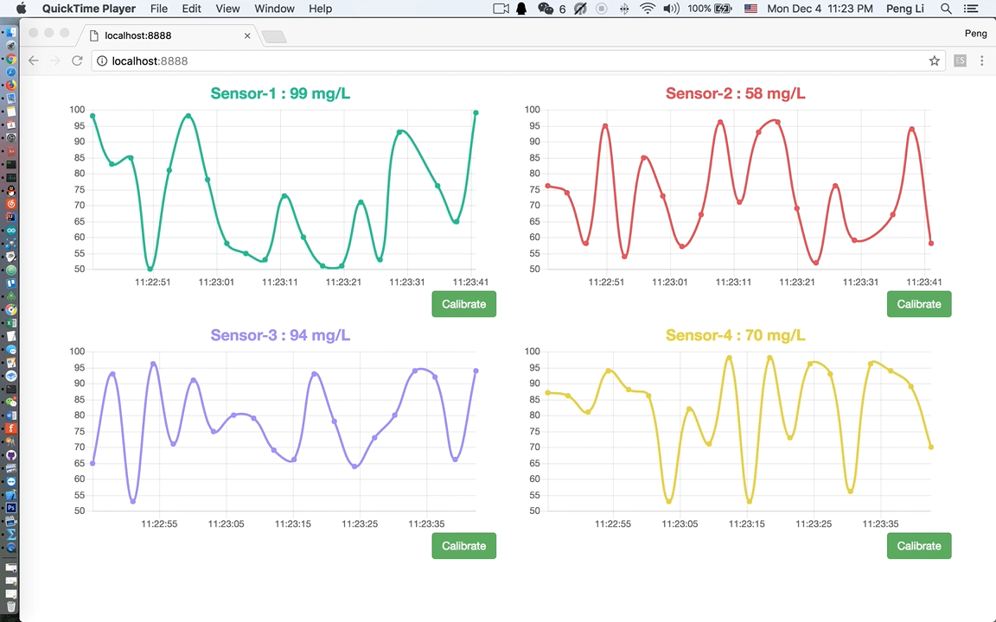
Notes:
Dashboard

Slide 36
Devices
Wireless
Security
Web
Calibration

Slide 37
Current Calibration

Slide 38
Current Calibration Procedure
Step 1 : Put the sensor into a calibration solution.
Step 2 : Remember some data points on a paper.
Step 3 : Put the sensor into another calibration solution.
Step 4 : Remember some other data points on a paper.
Step 5 : Manually calculate the parameters.
Step 6 : Input the parameters into the configuration file.
Step 7 : Restart the system.

Slide 39
Dynamic Calibration

Slide 40
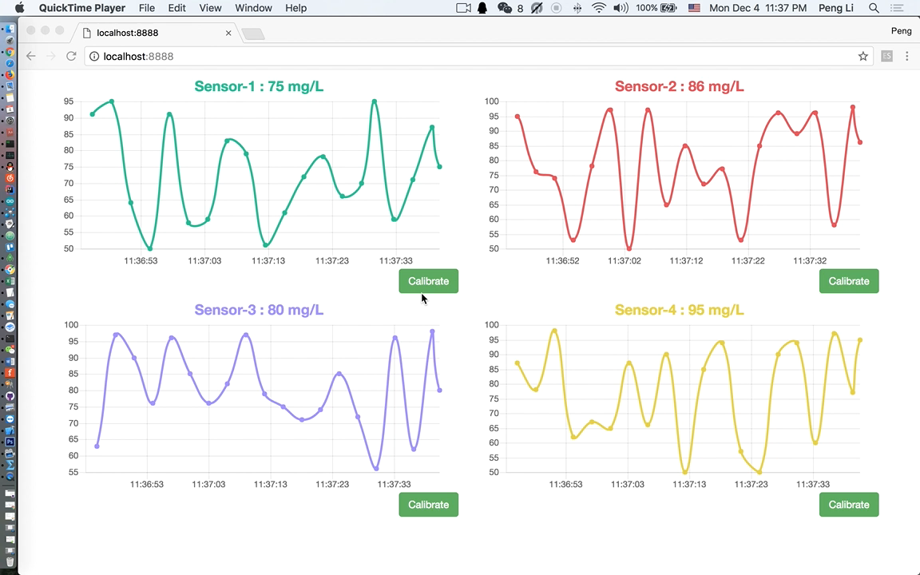
Notes:
Calibration

Slide 41
Devices
Wireless
Security
Web
Calibration
Integration

Slide 42
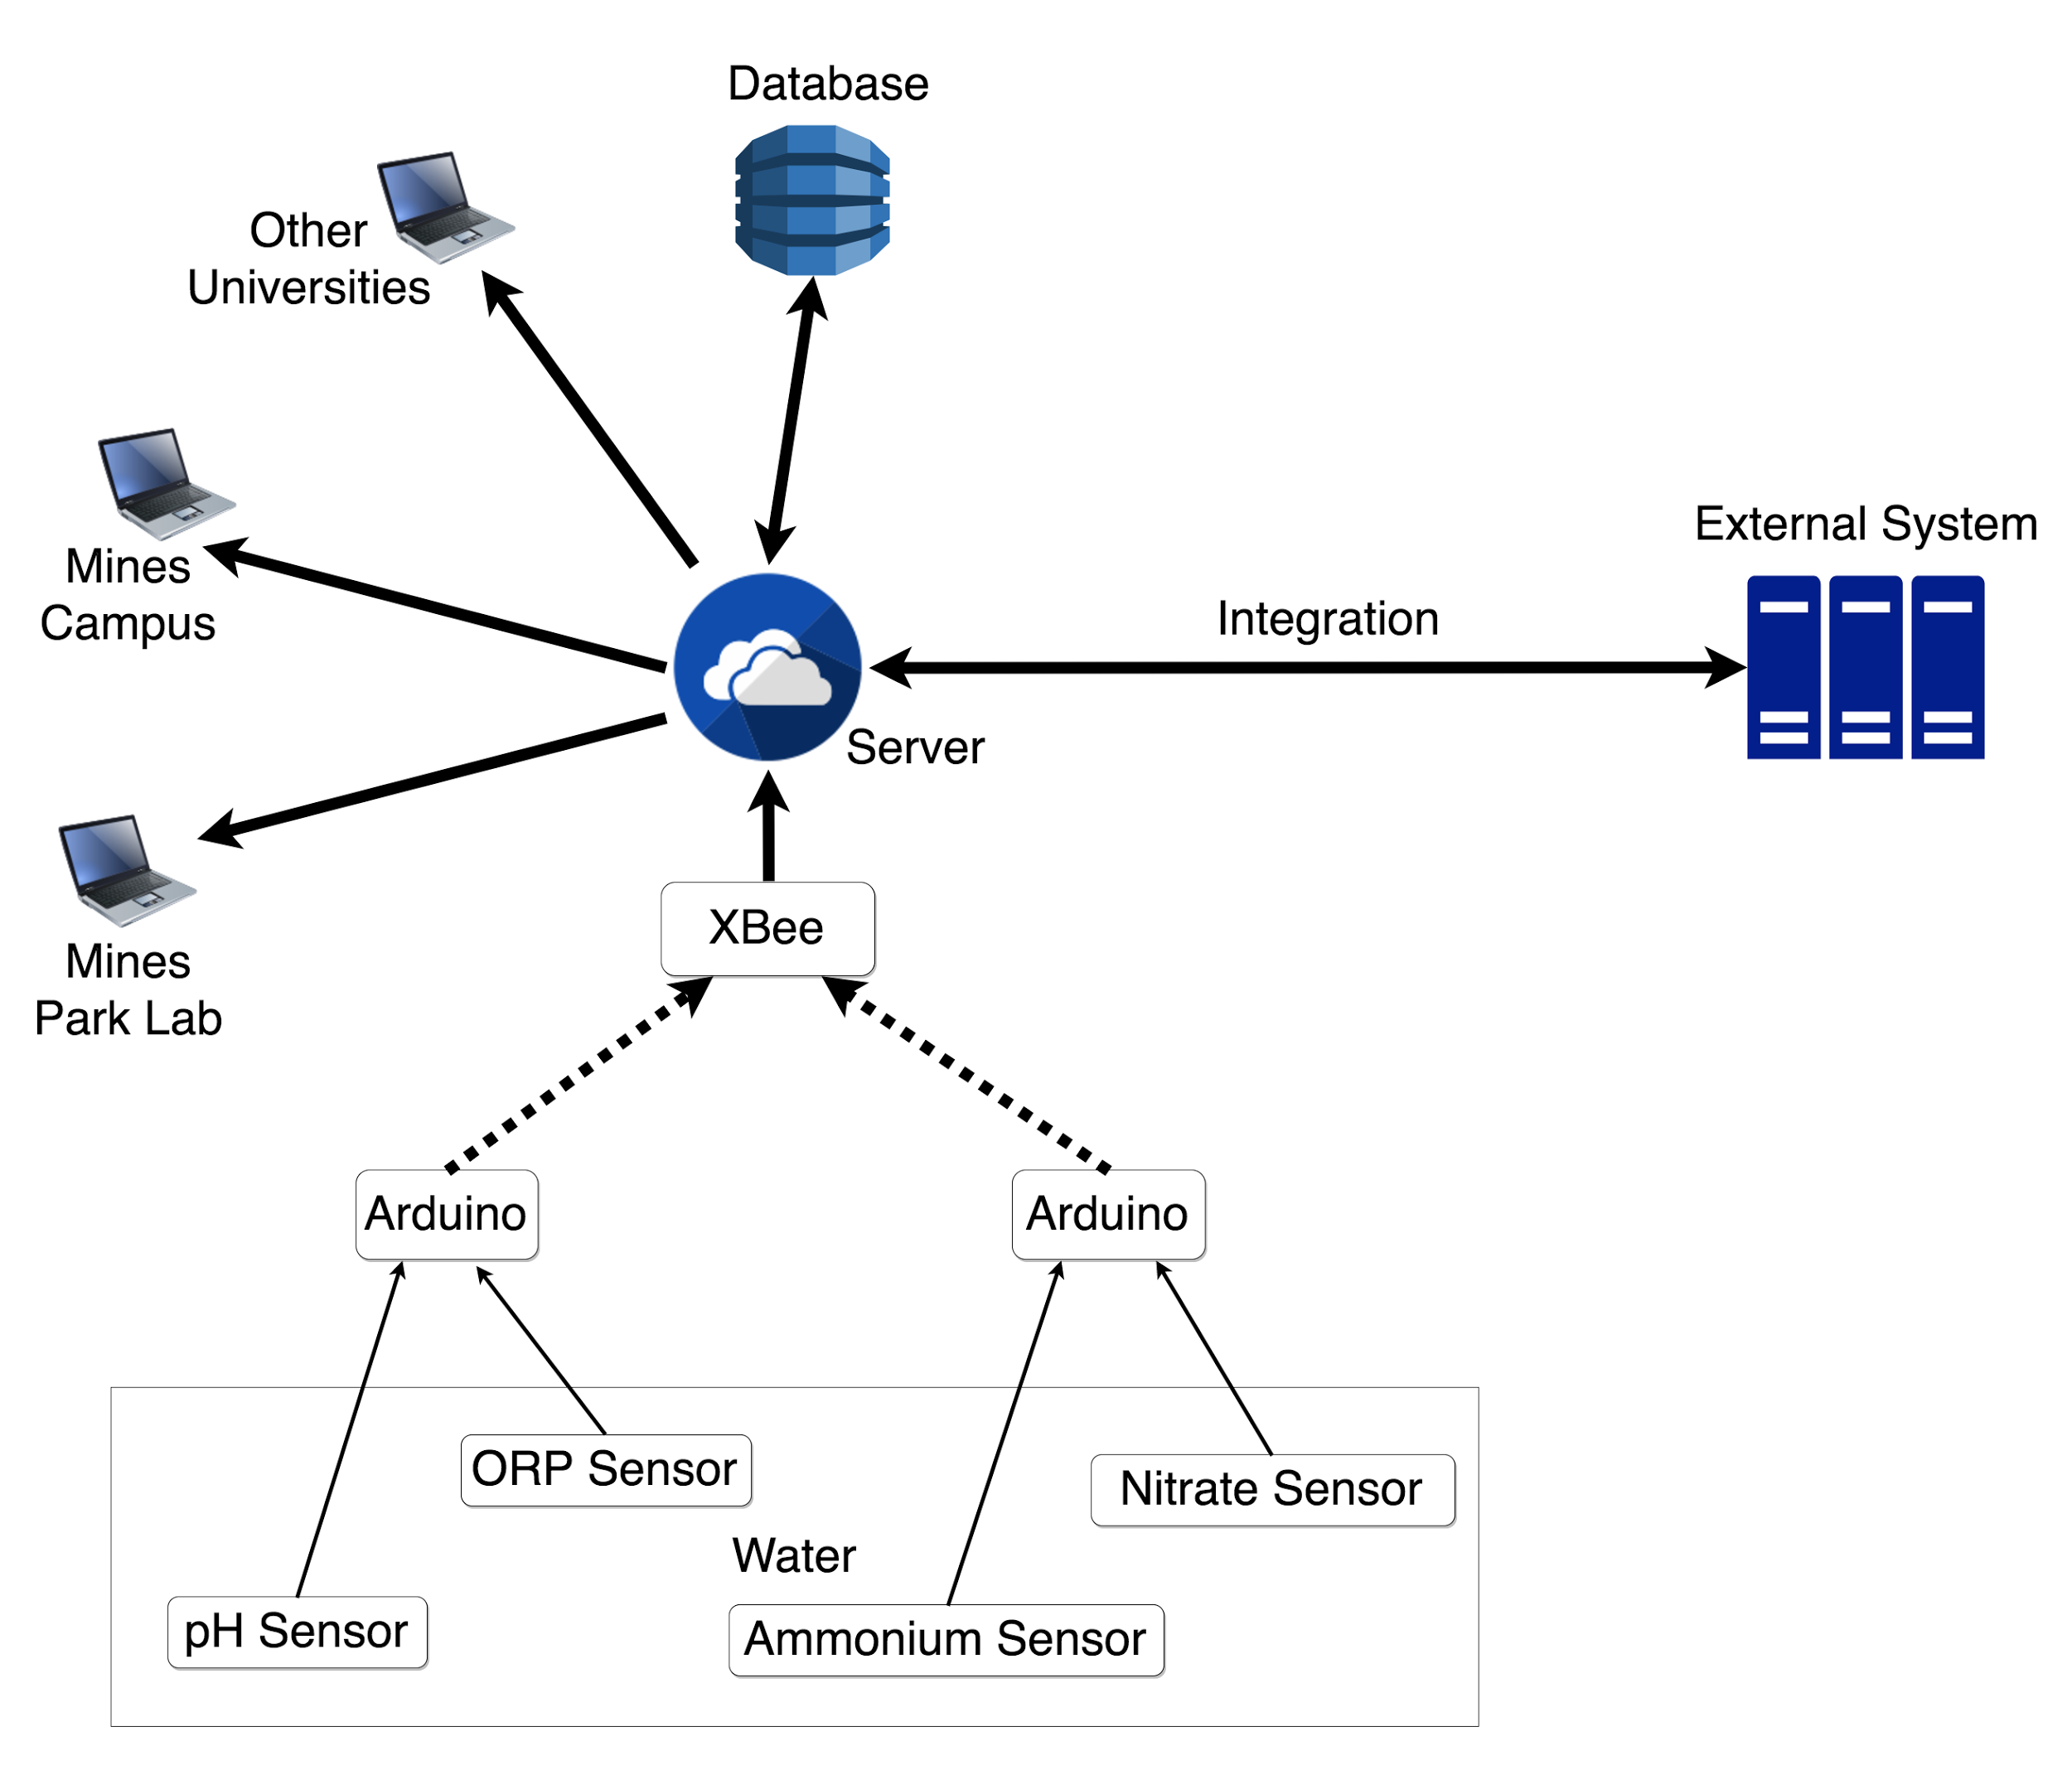

Web API
Notes:
The program running in the background is a complete Web Server, which means we can integrate with other systems whatever we want.

Slide 43
Devices
Wireless
Security
Web
Calibration
Integration

Slide 44

Thanks !

